Slide 1
Making a mobile chatbot app
With mobile architecture in mind
Arun Sivakumar (iOS Developer - arun.s@circles.asia)
Xyriz Tan (Android Developer - xyriz@circles.asia)

Slide 2
What is a chatbot?
A program that behaves as if it’s another user in a chat / social messaging platform.
Notes:
Arun

Slide 3
So what can you do with it?
Get customer support at any time of the day
Get weather forecast
Shop online
Check bus arrivals
Check your bank account / credit card spending
Help you learn foreign languages
Intelligent personal assistants like Siri(Apple) and Bixby(Samsung) are also chatbots fitted with speech recognition :)
Having someone to talk to :’’’(
Notes:
Xyriz

Slide 4
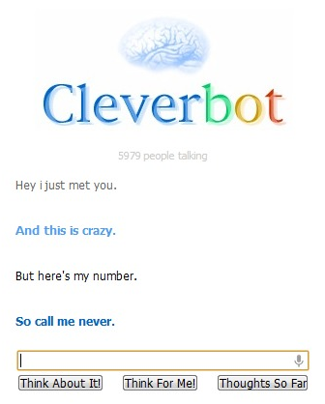


Slide 5
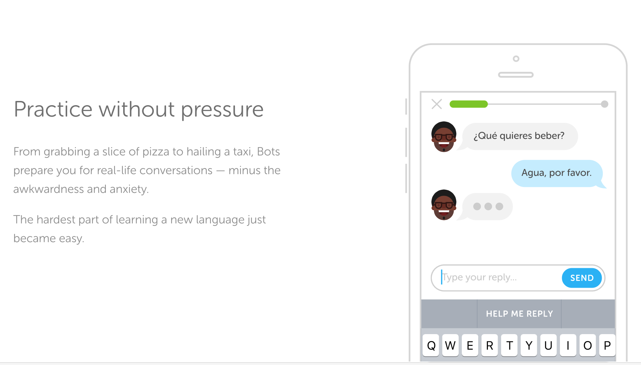
bots.duolingo.com

Slide 6
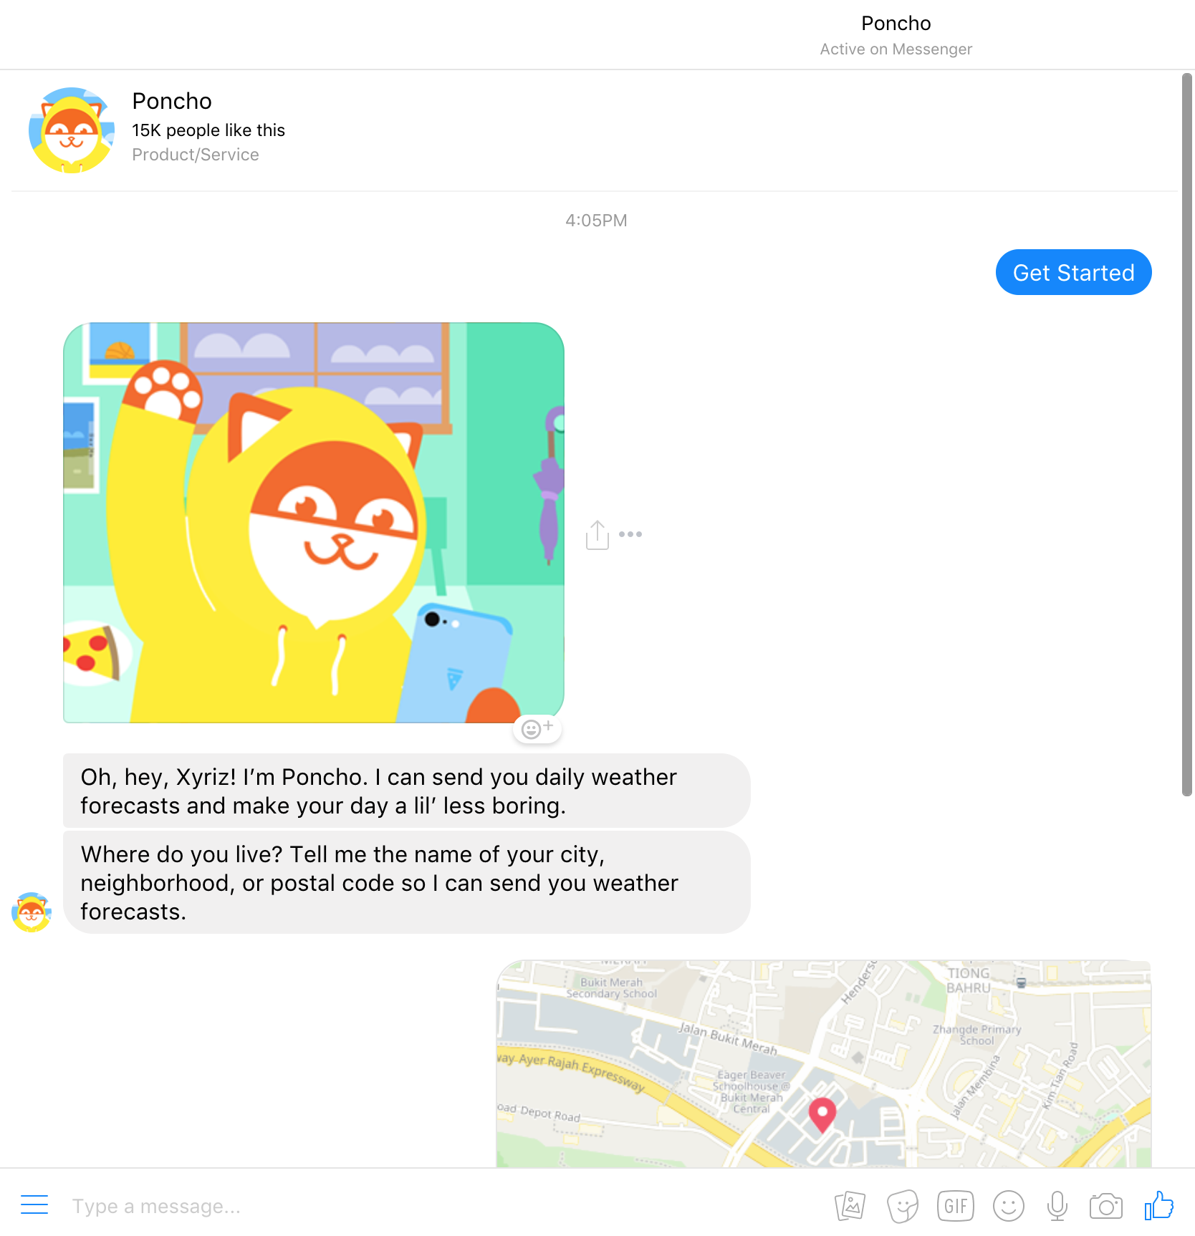
Poncho
Weather forecasts, horoscopes, and more.

Slide 7
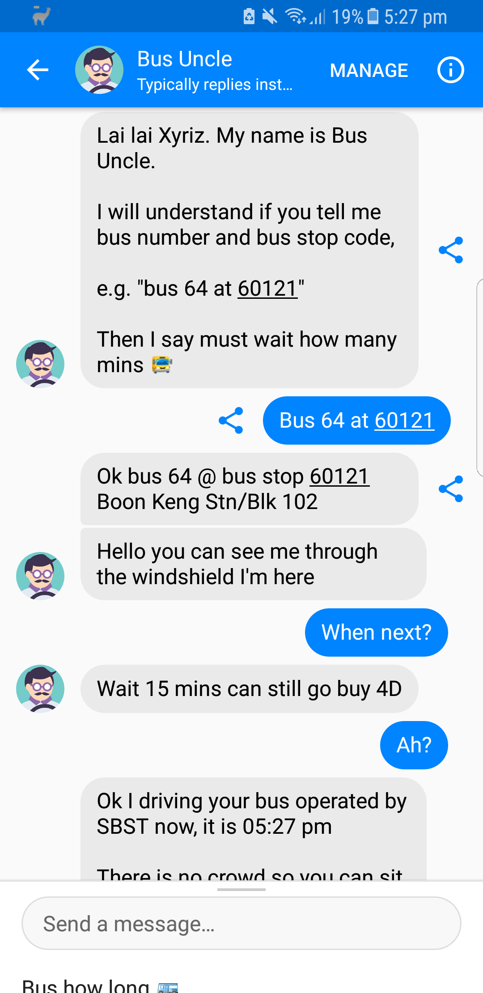
Bus Uncle

Slide 8
Benefits
Instant response / no hold time / available 24-7
80% of chat sessions with an actual person can be resolved by a chatbot
Manpower can be allocated more effectively (example: focus on customers with more urgent concerns)
When executed properly, not only will it be cost-saving but it can generate revenue and leads as well.

Slide 9
Let’s make one!
Goal: Chatbot app module that can answer frequently asked questions about Circles.Life:
Backend chatbot service to connect with (Microsoft QnA Maker, Google DialogFlow, IBM Watson)
Configuring and pre-populating the chatbot service with sample conversations and routines (knowledge base)
User facing chat app(Web, mobile)
Notes:
Show services such as Google DialogFlow, Microsoft QnA

Slide 10
Make an account at https://qnamaker.ai/
Configure knowledge base - in this case we can use qnamaker’s functionality that takes in a url and they will do the web scraping + crawling for us. Neat!
Clean up the scraped data (for example, it would sometimes scrape the actual markdown source of the page)

Slide 11
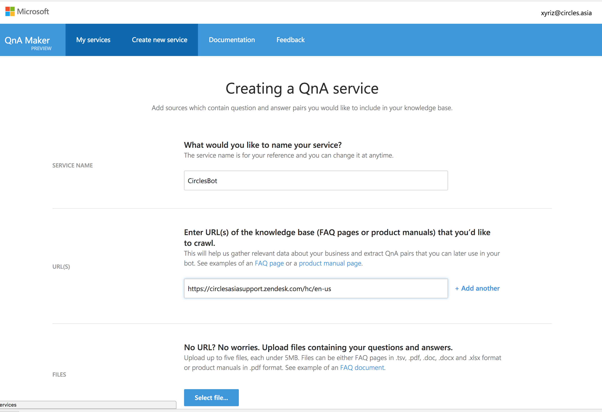

Slide 12
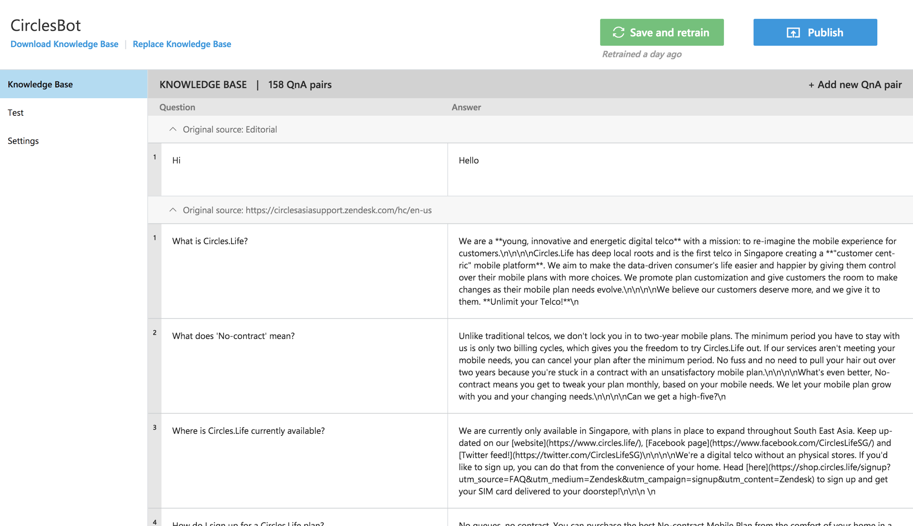

Slide 13
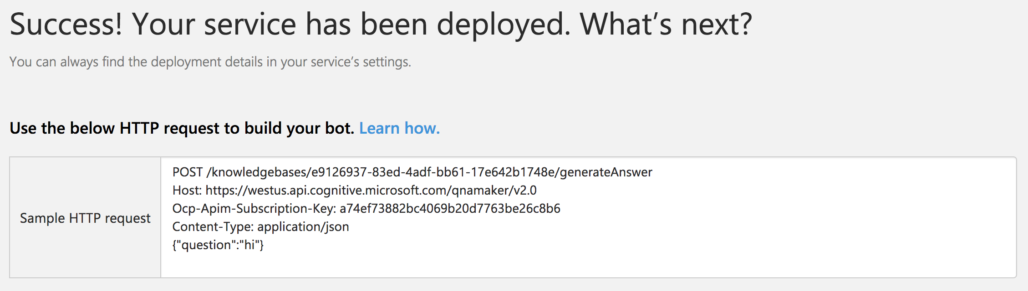
Deploy knowledge base

Slide 14
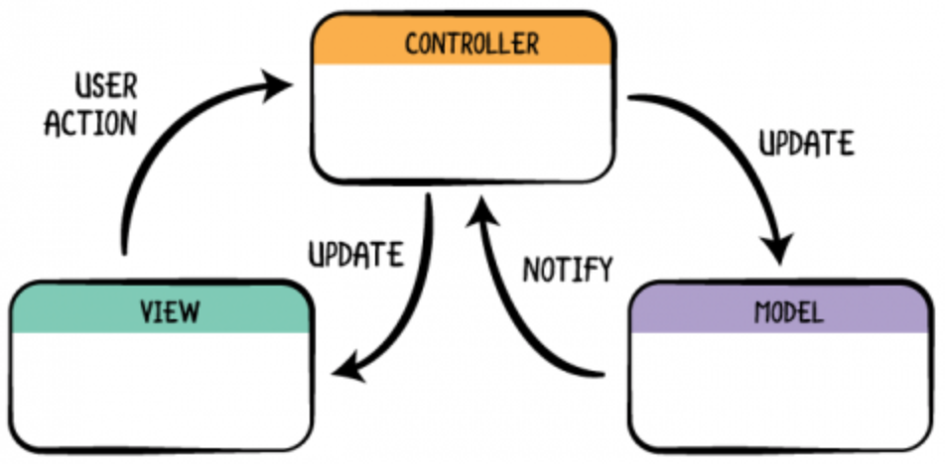
M-V-C
Model-View-Controller.
What is it?
is a software architectural pattern commonly used for developing user interfaces that divides an application into three interconnected parts

Slide 15
M-V-C
Massive-View-Controller ???!!!
What is it?
Hack : MVCS(Model-View-Controller-Store)
Store

Slide 16
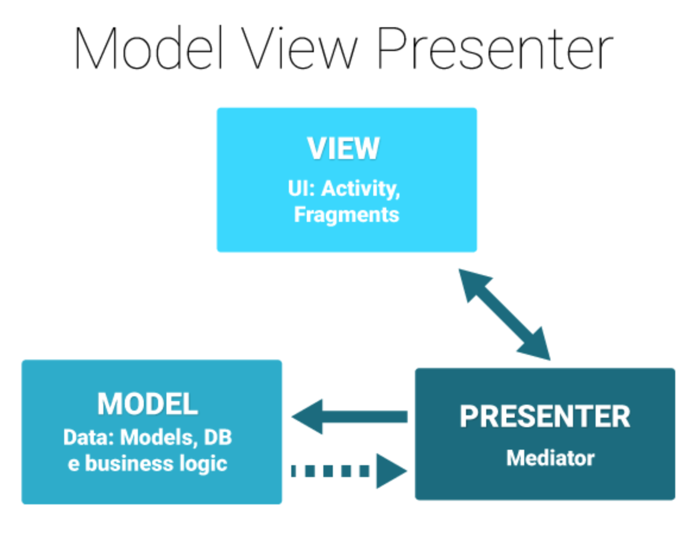
M-V-P what? Some new Ministry in SG?
No silly, MVP stands for Model-View-Presenter.
What is it?
It’s a software architectural pattern that aims to separate (decouple) major components of a software.
It’s way easier to know which part of software does what

Slide 17
Simple overview of MVP
Model: Defines the data we work on and the interfaces required to expose it to whoever needs it (the Presenter.)
View: Just a passive interface whose sole responsibility is to just display data, its functionality should only be limited to verbs related to UI (show, hide, scroll, updateValue.)
Presenter: The glue between View and Model, receives request from View (for example, a button), then requests for the data to the Model, then finally, formats the result and reports it to the View.

Slide 18
Good Mobile Architecture
BUSINESS LOGIC
UI/UX
NETWORKING
PERSISTENCE
Avoid Massive View Controller Problem
Be careful about Inheritance (Alternative: Protocol Oriented Programming)
Activity / View Controller 300-400 Lines of code
Don’t block the UI Thread

Slide 19
Code!

Slide 20
Good Programming Practices
Know your Data Structure & Algorithms
Understand Object Oriented Programming, Protocol oriented Programming, Functional Programming
Design Principles
SOLID Principles
TDD

Slide 21
Thanks!
GitHub links:
Android (Kotlin): https://github.com/Saiseizuki/CirclesBot
iOS (Swift): https://github.com/arunsivakumar/CirclesBot
Notes:
Put github link here:
Android: https://github.com/Saiseizuki/CirclesBot

